Slide 1

Course Code: MATH 211
Course Title: MATH III
Lecture 7,8 (Line Integral)
Tazin Tamanna
Lecturer in Mathematics
Department of Science and Humanities
M.Sc. in Applied Mathematics (KU)
B.Sc. in Mathematics (KU)

Slide 2
Line Integral
Solution:

Slide 3
Solution:

Slide 4
Solution:
DO YOURSELF

Slide 5
Solution:

Slide 6
Solution:

Slide 7
Solution:

Slide 8
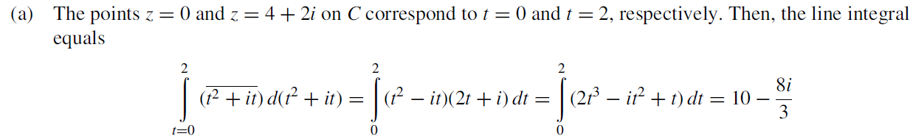
Solution:

Slide 9
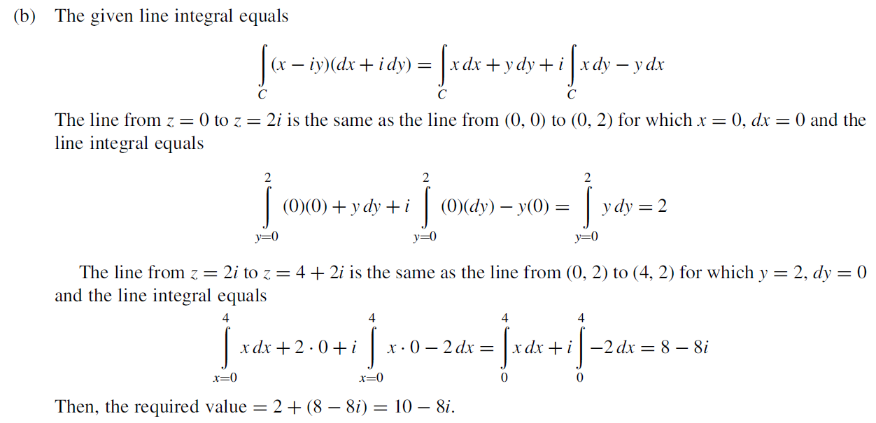

Slide 10
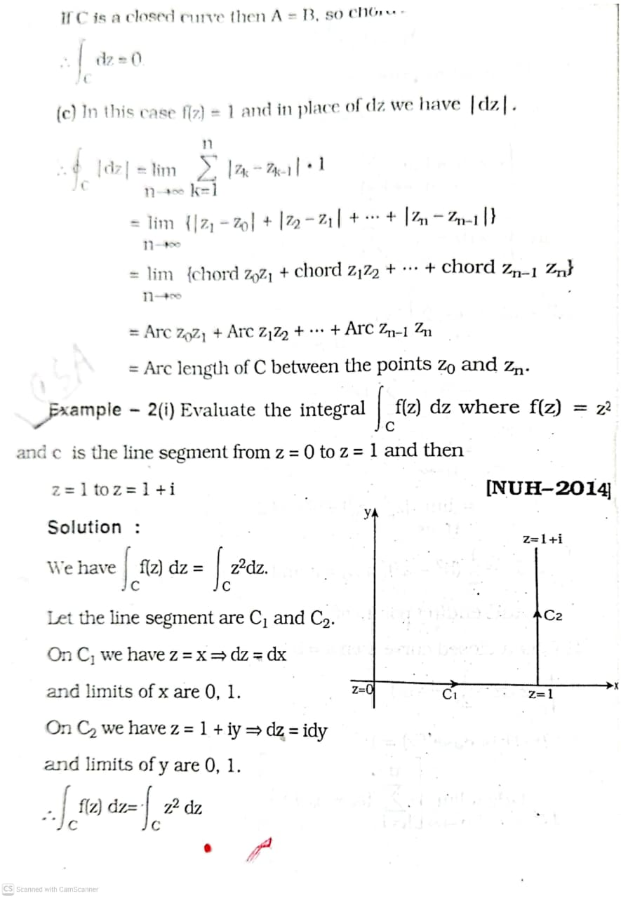

Slide 11
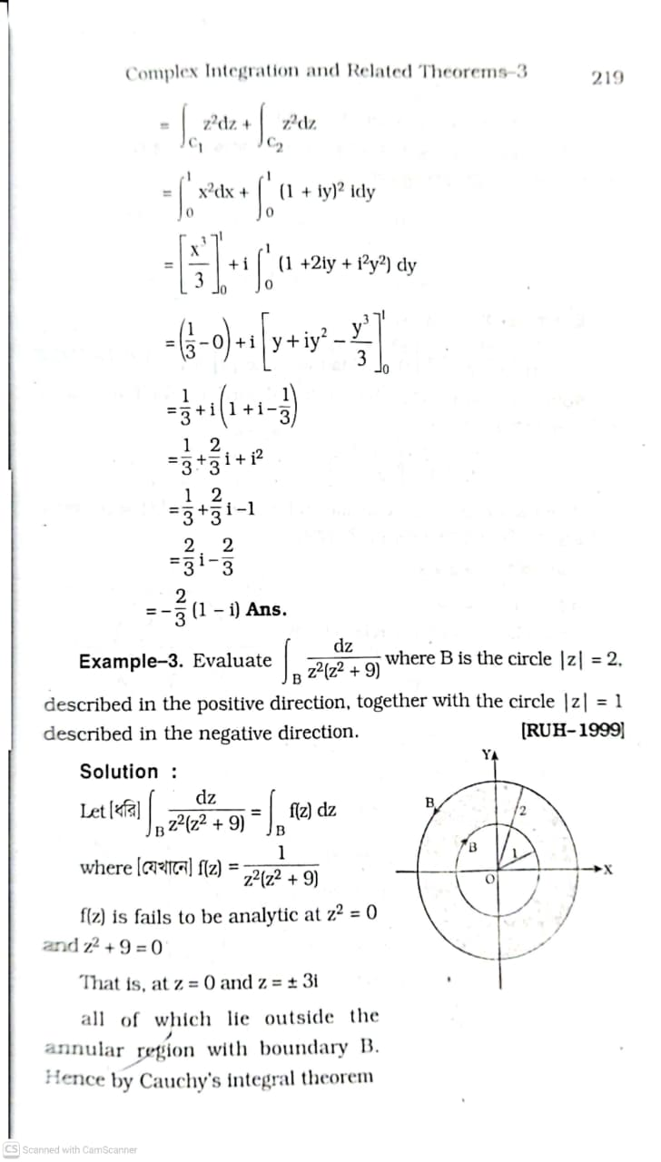

Slide 12
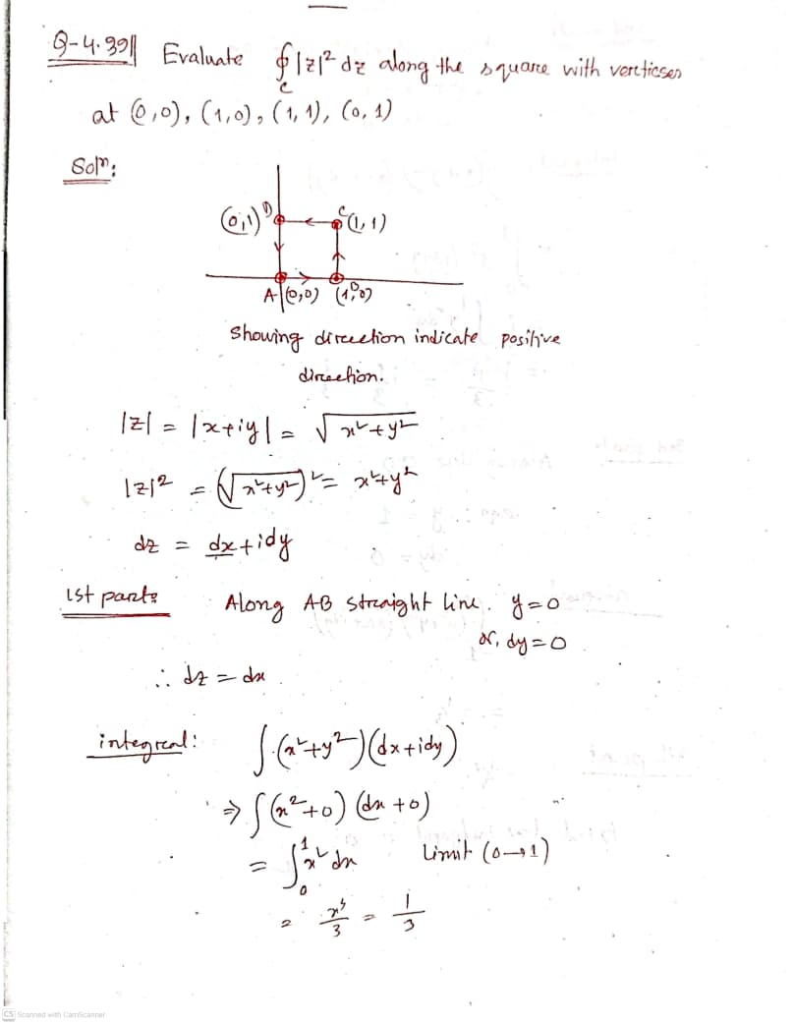
DO YOURSELF
Example 5:

Slide 13
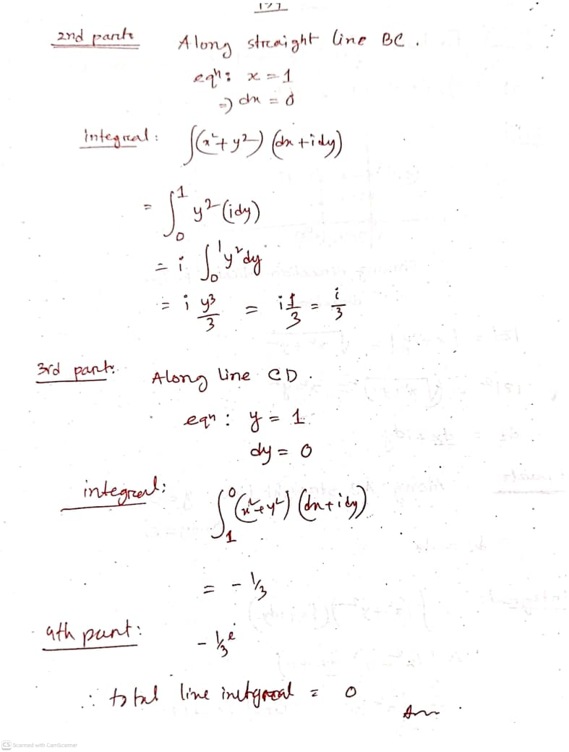

Slide 15
Example 6:

Slide 17
Example 7:

Slide 19
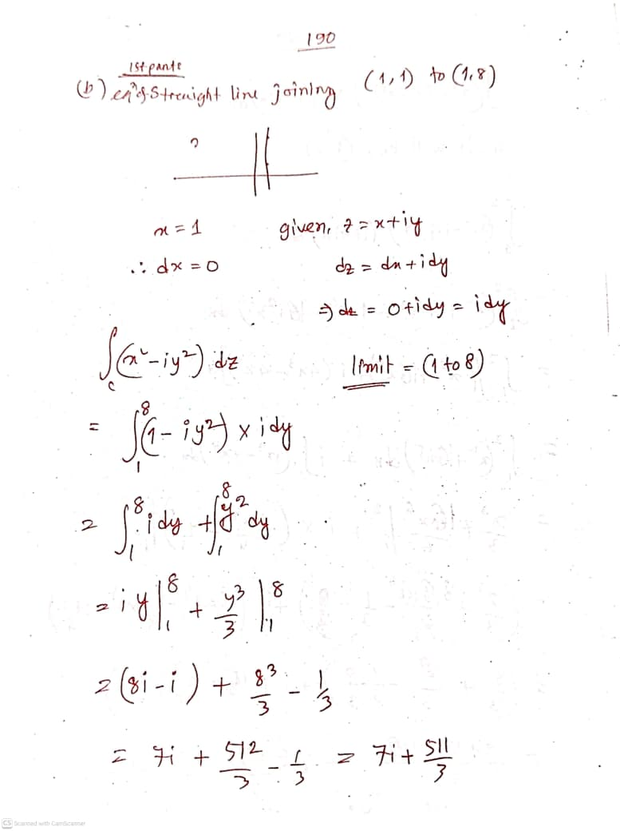

Slide 21
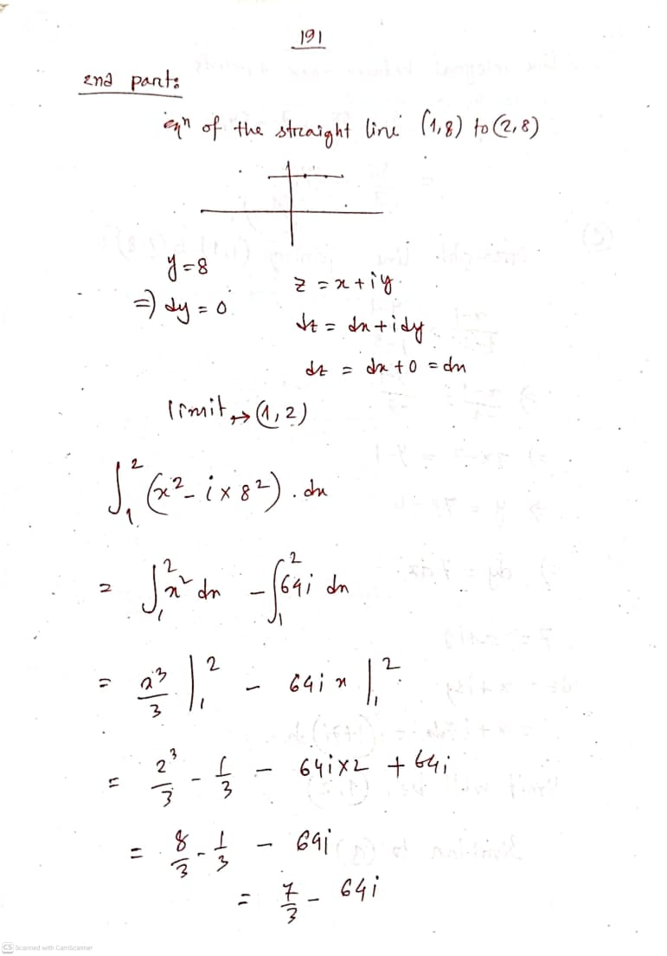

Slide 22
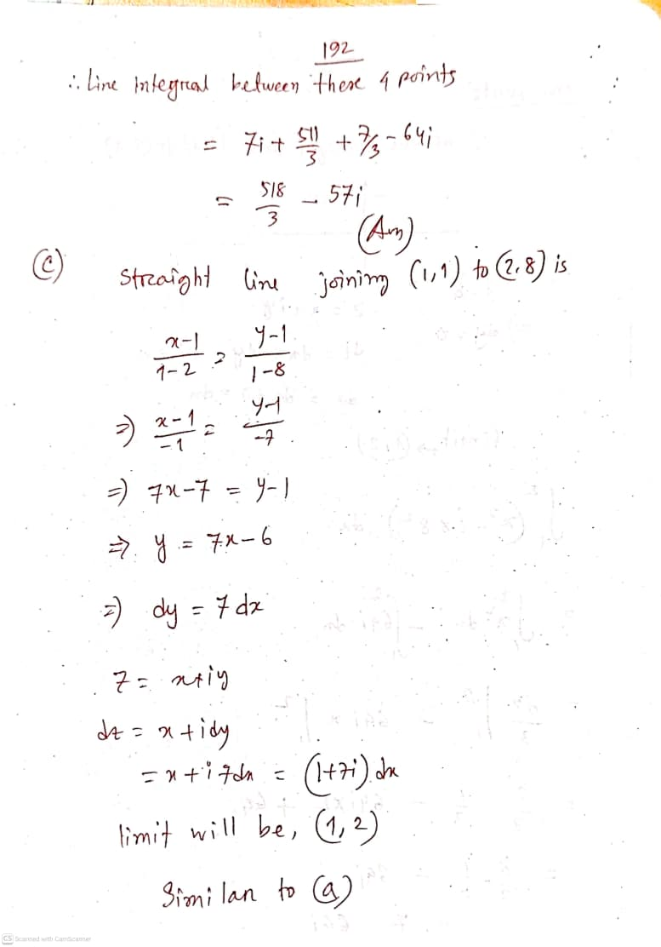

Slide 24
Example 8:

Slide 25
(After integration)

